Slide 1



revenve reports
View in Power BI
Last data refresh:
19-03-2021 07:46:52 UTC
Downloaded at:
30-06-2021 11:37:16 UTC

Slide 2
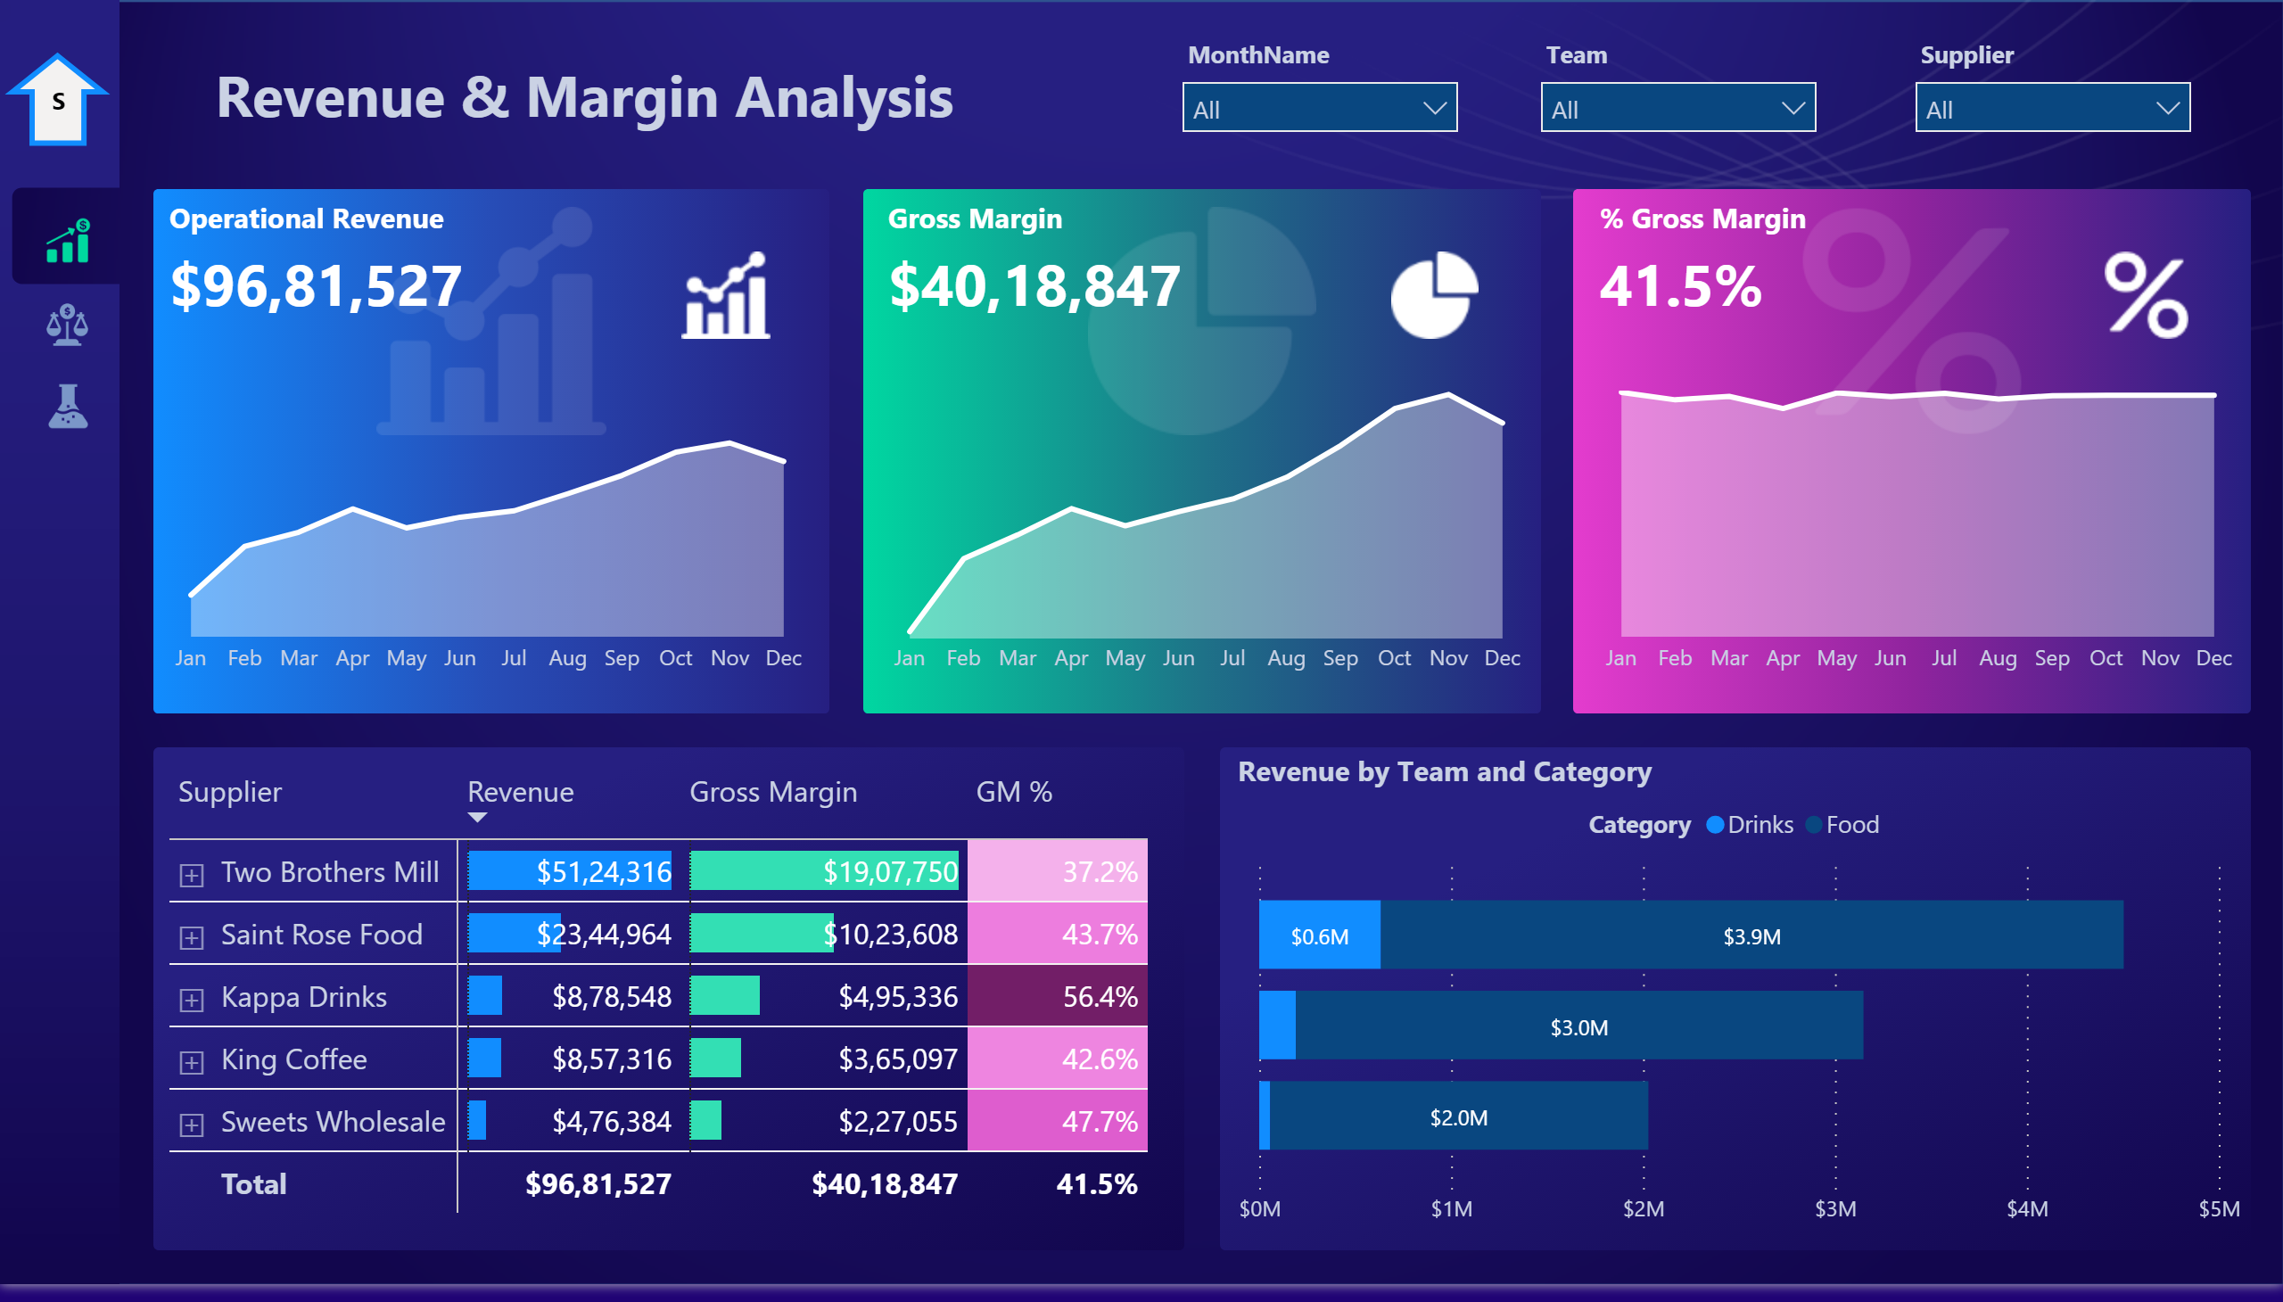
Revenue & Margin
Notes:
barChart
No alt text provided.
Operational Revenue
No alt text provided.
pivotTable
No alt text provided.
areaChart
No alt text provided.
textbox
No alt text provided.
slicer
No alt text provided.
slicer
No alt text provided.
slicer
No alt text provided.
Gross Margin
No alt text provided.
% Gross Margin
No alt text provided.
areaChart
No alt text provided.
areaChart
No alt text provided.
image
No alt text provided.
image
No alt text provided.
image
No alt text provided.
basicShape
No alt text provided.
textbox
No alt text provided.

Slide 3
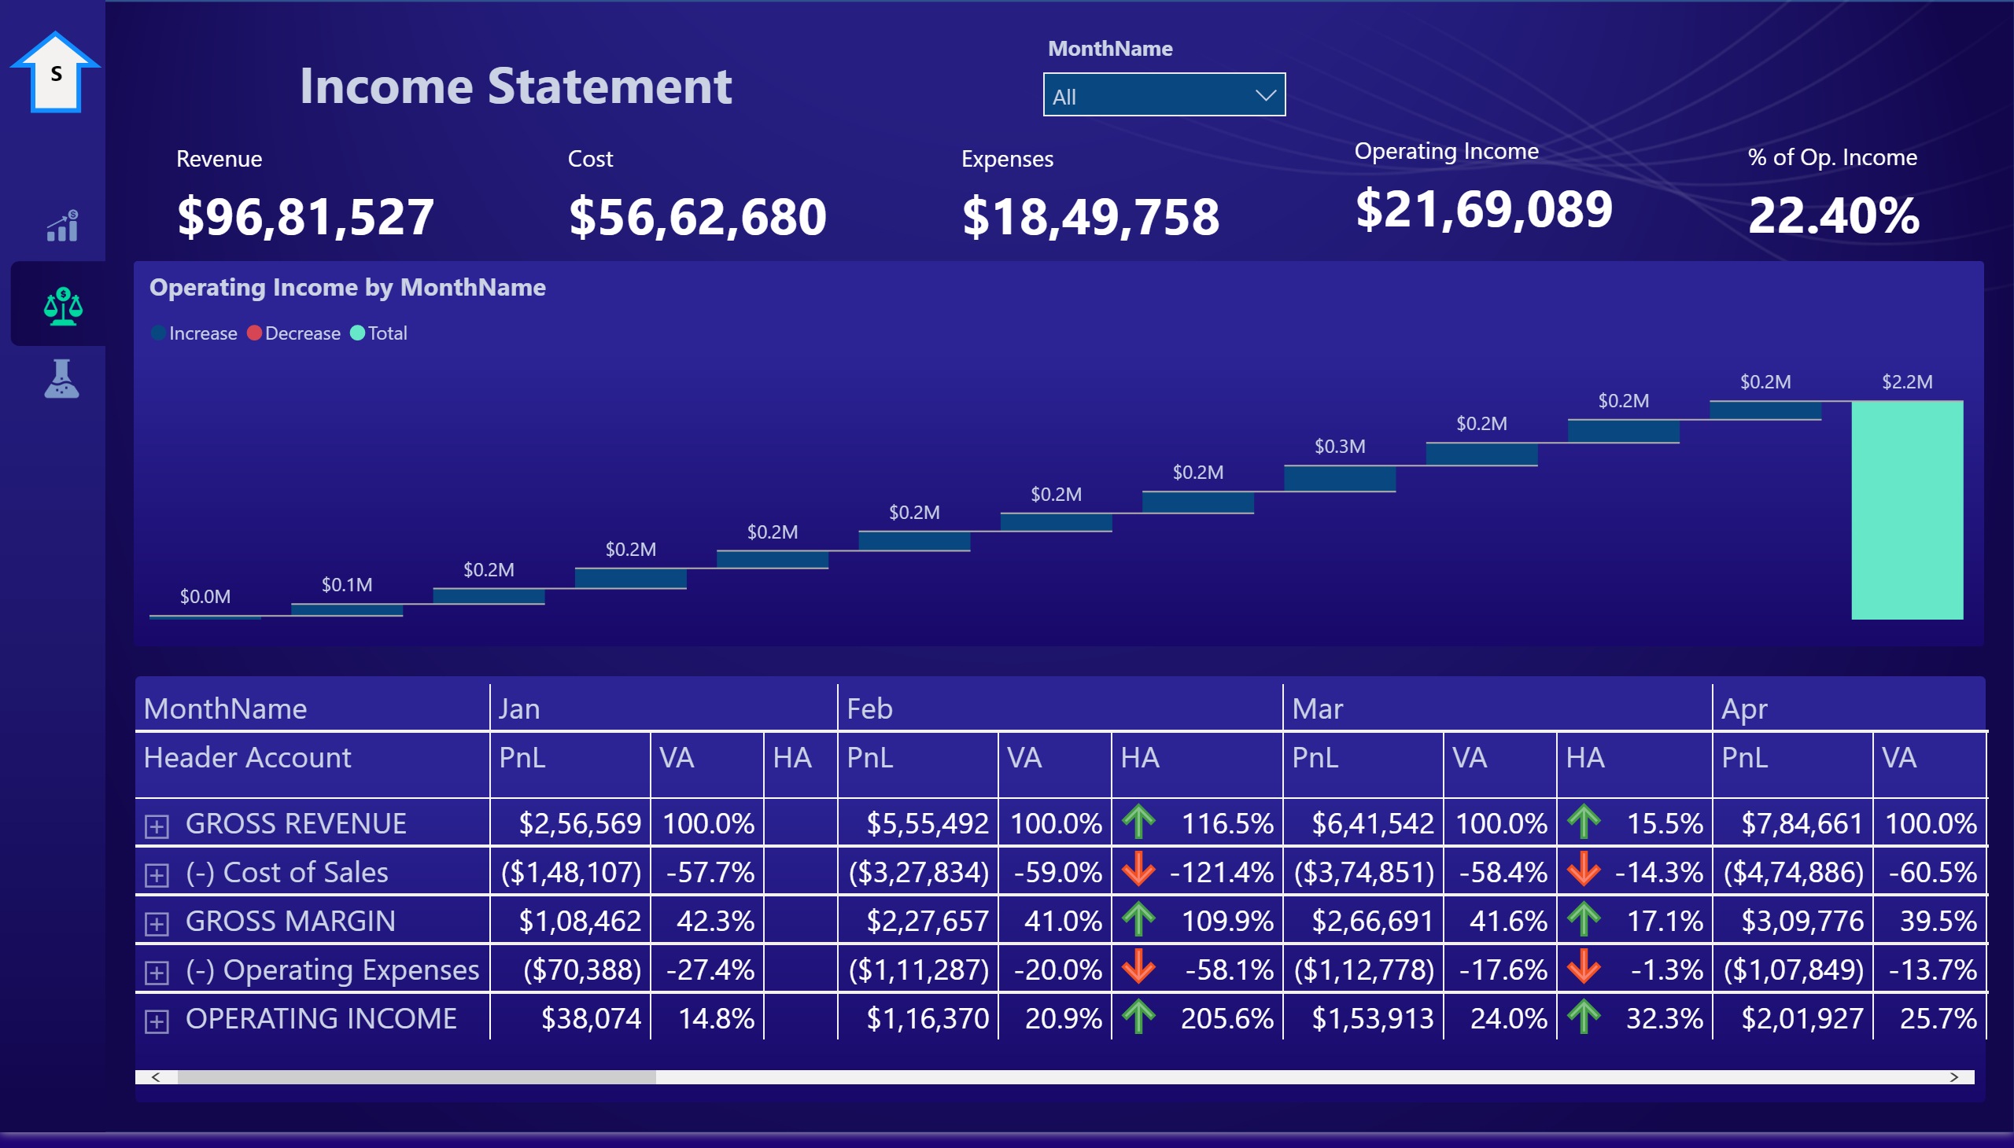
Income Statement
Notes:
image
No alt text provided.
image
No alt text provided.
image
No alt text provided.
textbox
No alt text provided.
slicer
No alt text provided.
textbox
No alt text provided.
basicShape
No alt text provided.
Revenue
No alt text provided.
pivotTable
No alt text provided.
Cost
No alt text provided.
Operating Income
No alt text provided.
% of Op. Income
No alt text provided.
Expenses
No alt text provided.
waterfallChart
No alt text provided.

Slide 4
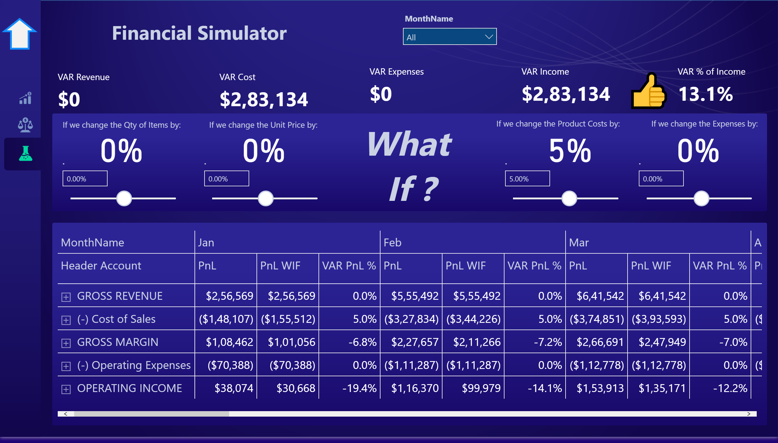
Financial Simulator
Notes:
image
No alt text provided.
image
No alt text provided.
image
No alt text provided.
textbox
No alt text provided.
slicer
No alt text provided.
slicer
No alt text provided.
slicer
No alt text provided.
slicer
No alt text provided.
slicer
No alt text provided.
card
No alt text provided.
card
No alt text provided.
card
No alt text provided.
card
No alt text provided.
pivotTable
No alt text provided.
VAR Revenue
No alt text provided.
VAR Cost
No alt text provided.
VAR Expenses
No alt text provided.
textbox
No alt text provided.
textbox
No alt text provided.
textbox
No alt text provided.
textbox
No alt text provided.
textbox
No alt text provided.
textbox
No alt text provided.
basicShape
No alt text provided.
VAR Income
No alt text provided.
VAR % of Income
No alt text provided.
card
No alt text provided.

Slide 5
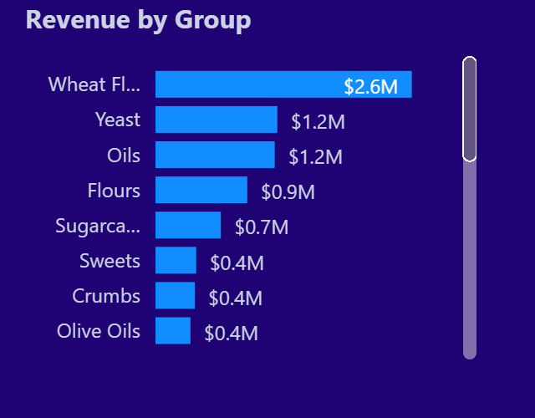
TooltipTest
Notes:
barChart
No alt text provided.

